Slide 1

FOOD DONATION
PRESENTED BY,
NAWFAL
AMBIKA
GAYATHRI

Slide 2
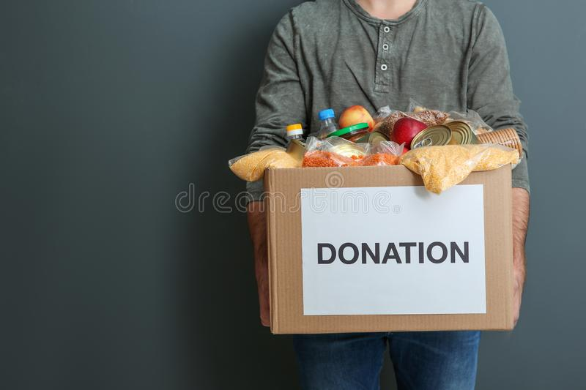
Agenda
PROBLEM STATEMENT
OBJECTIVES
USE CASE DIAGRAM
CLASS DIAGRAM
ER DIAGRAM

Slide 3
PROBLEM STATEMENT
Now a Days wasting food is a common problem in our society.
Instead of wasting these food we can put them in use by donating them to various organizations such as orphanages, old age homes , needy etc.
Hence came up with a website that is designed in such a way that connects the donor , NGO and the people who need food.
An NGO volunteer will collect the food from the donor and serve to the needy by means of this website.

Slide 4
OBJECTIVES
The main objective of the NGO is to feed the poor people . The objective of our application is to enable a link of communication and interactions among NGOs, donors and the needy.
The people wishing to donate will be able to see all the options available with them to do the same. The item they wish to donate then shall be collected by a volunteer who is connected to the donors via our application.
The donated item shall safely reach the intended needy persons after this interaction. In other words, our project has the following objectives:
1. Reduce lack of awareness
2.Enable easy interaction between donors and organizations
3.Make work faster and quicker by digitising it via our website

Slide 5
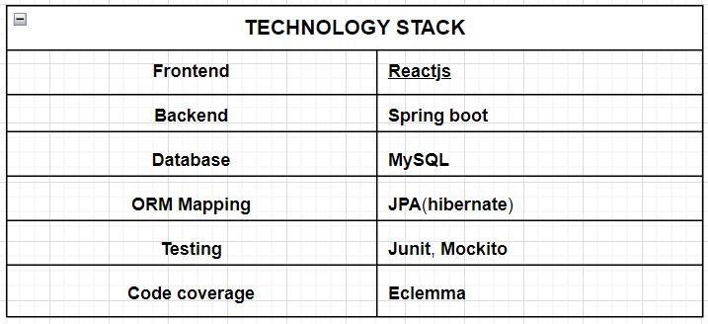
TECHNOLOGY STACK

Slide 6
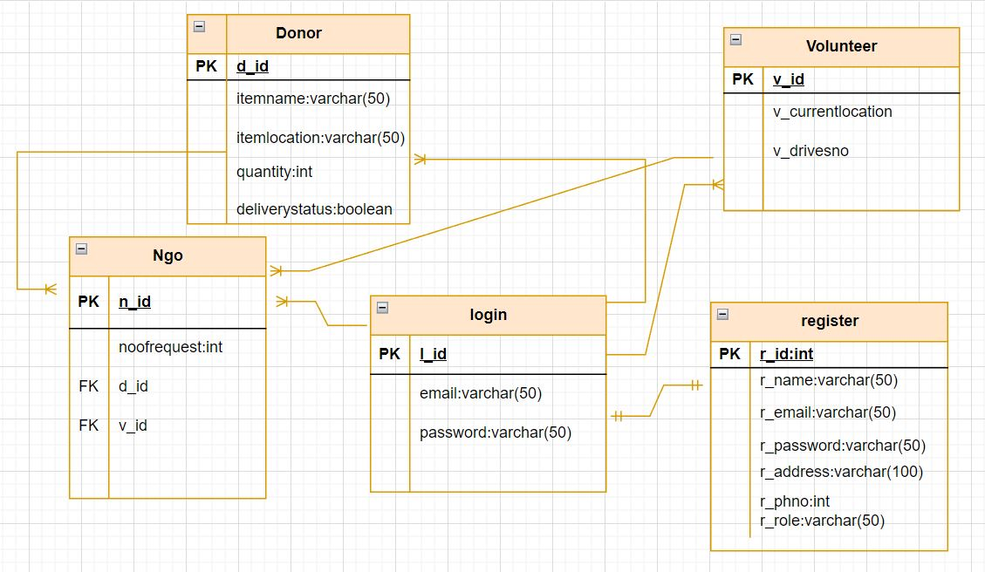
ER DIAGRAM

Slide 7
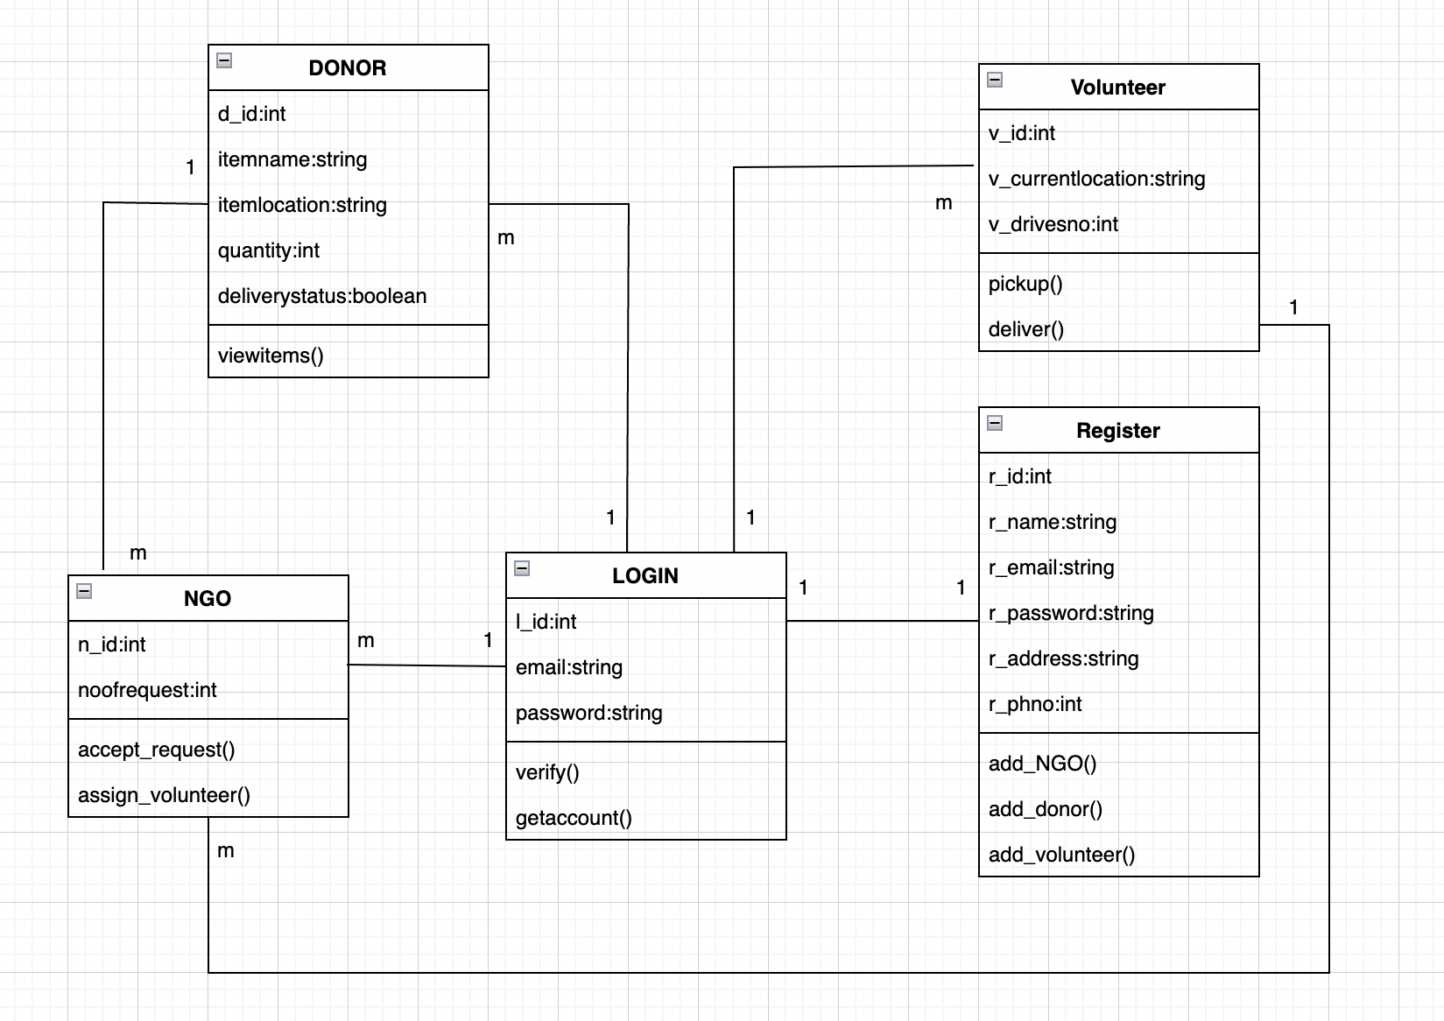
CLASS DIAGRAM

Slide 8
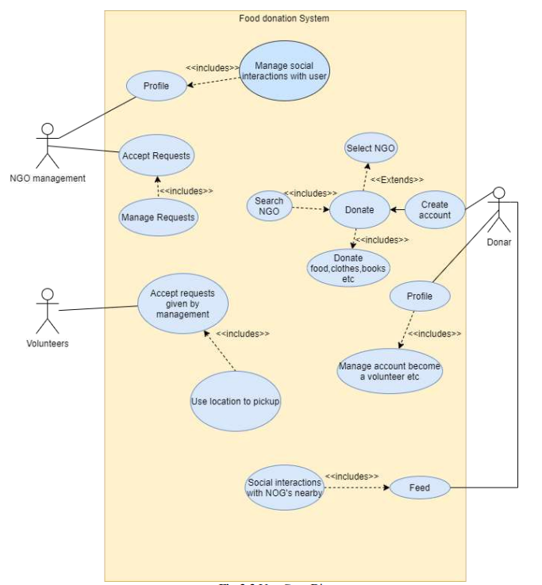
USE CASE DIAGRAM

Slide 9
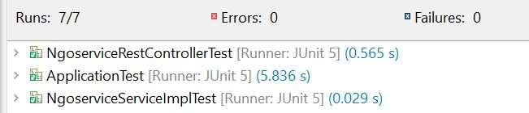
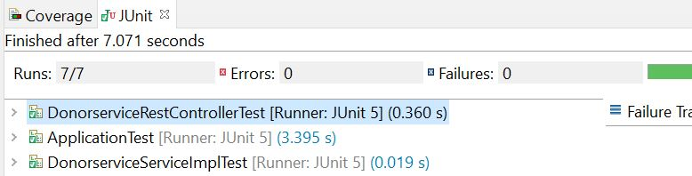
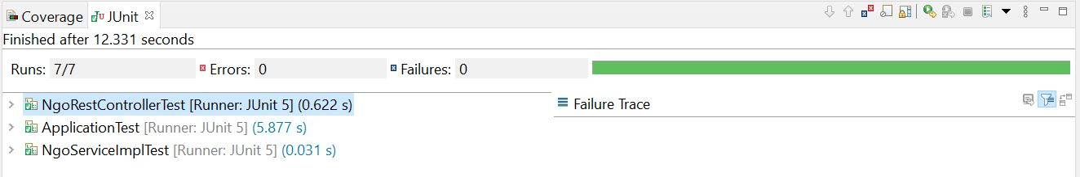
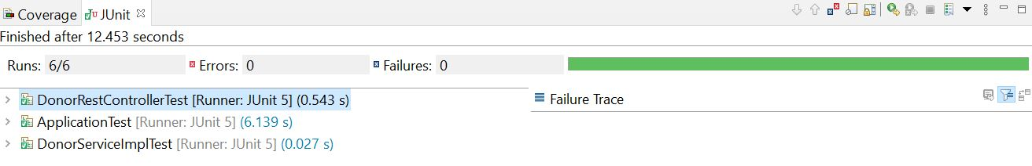
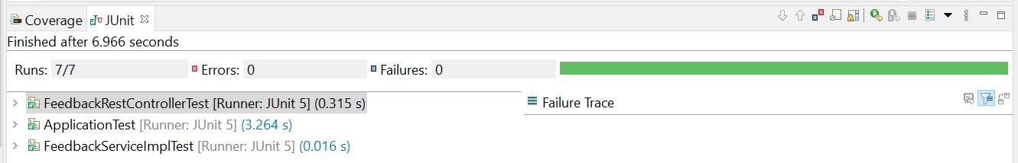
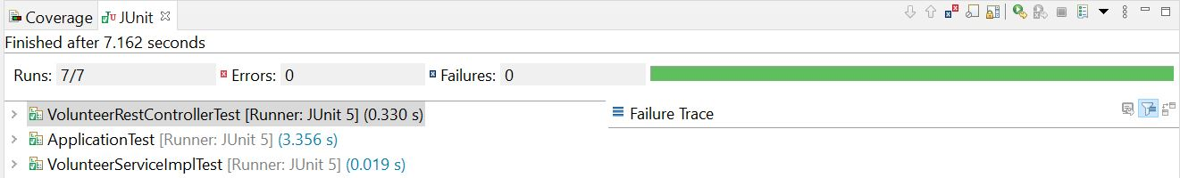
Testcases:

Slide 10
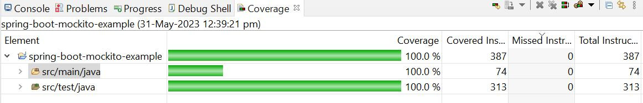
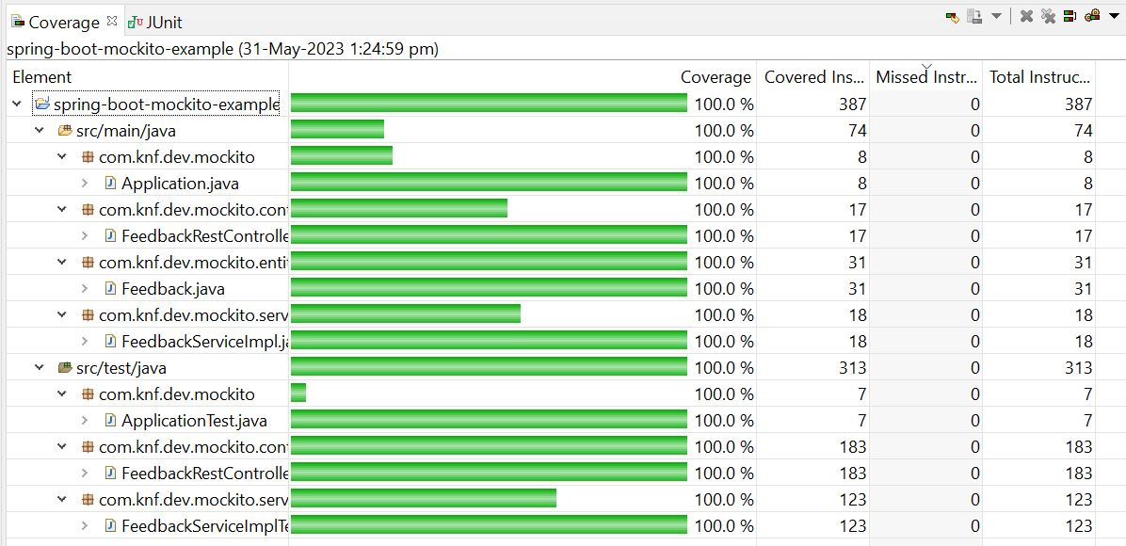
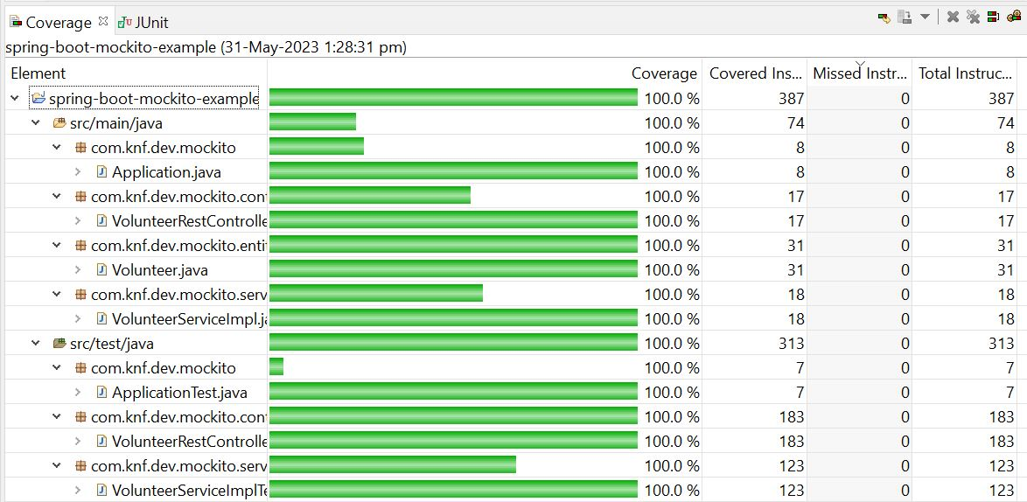
Code coverage:

Slide 11
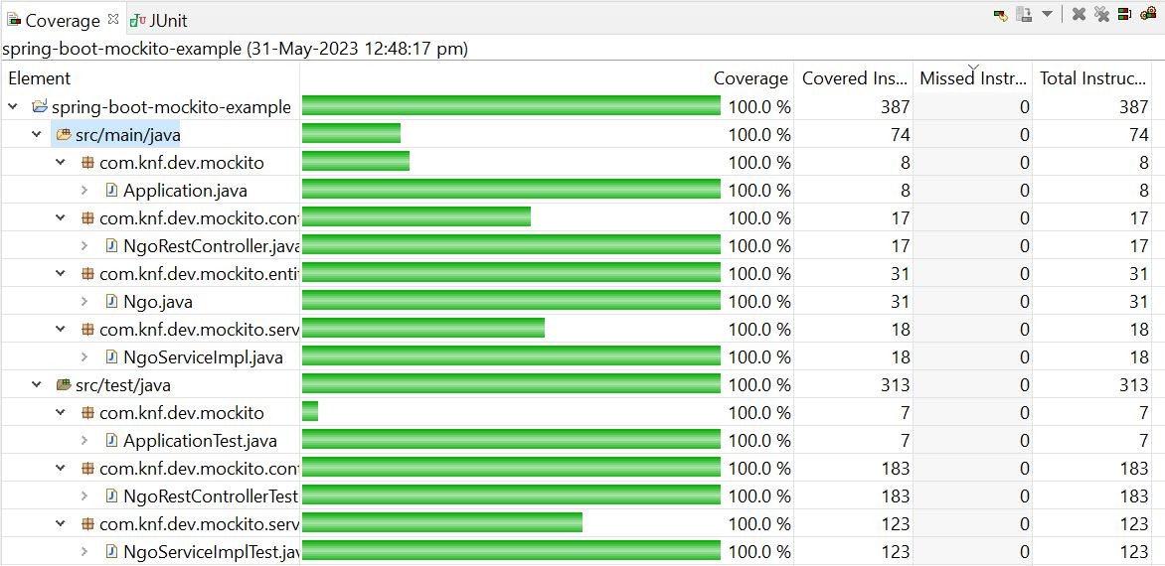
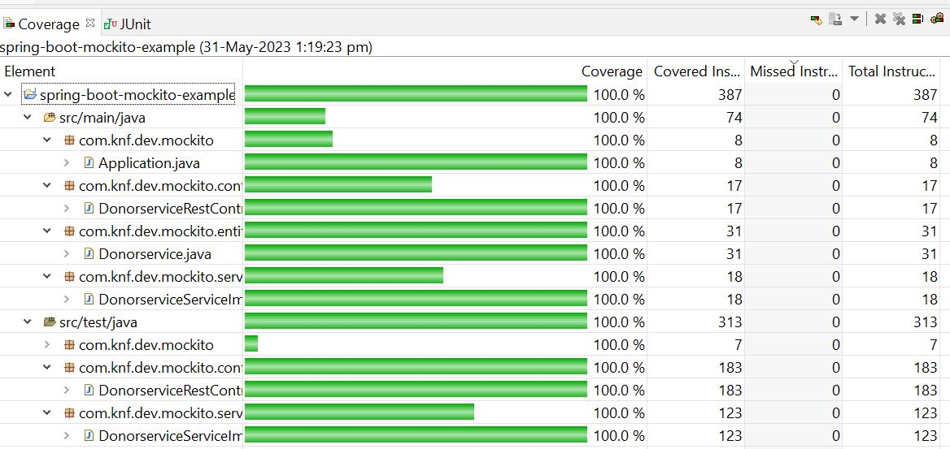
Code coverage:

Slide 12
Conclusion
The food donation website provides a platform where donors can log in and post their donation items to their preferred NGO. NGOs can also log in to the website to view the donor names and assign volunteers for food pickup and delivery to the needy. The website's login functionality enhances transparency, accountability, and efficiency, fostering a collaborative and impactful environment for addressing food insecurity.

Slide 13
THANK YOU

